Slide 1
Final Project
5731095821 - Wasuwat Satittamajittra

Slide 2
1. DTW Modifications
A. Asymmetric weights
DTW + 1NN
Data are Z-normalized
L2(Euclidean) distances
Sakoe-Chiba band (Window length = Sample length/10)

Slide 3
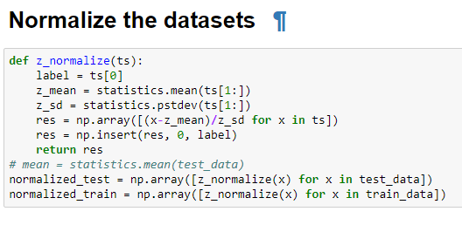
Z-normalize

Slide 4
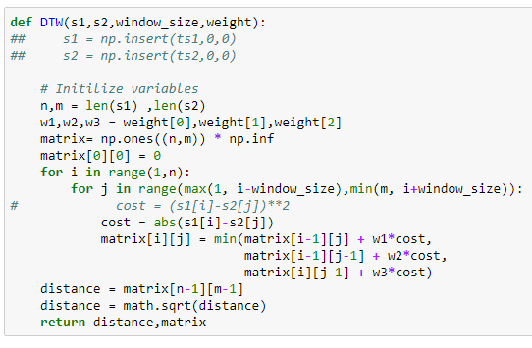
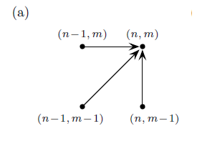
Dynamic Time Warping (DTW)

Slide 5
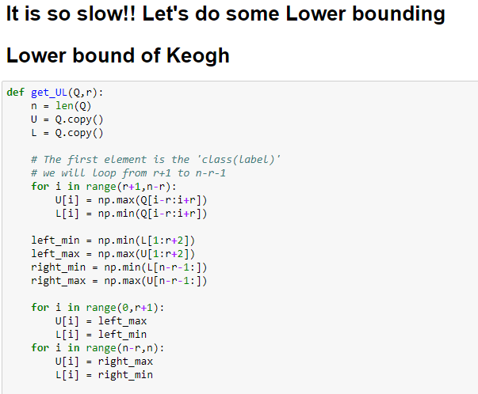
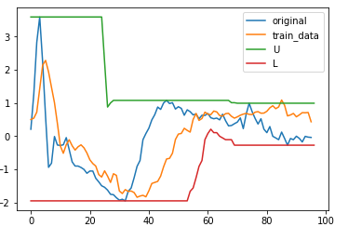
Lower Bound of Keogh

Slide 6
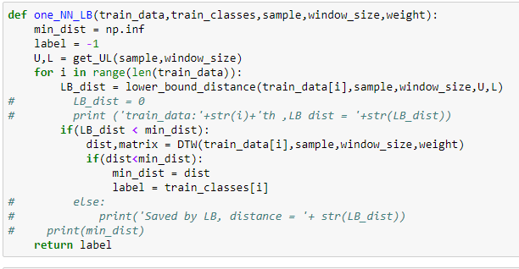
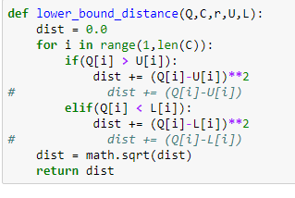
1 Nearest Neighbor (1NN)

Slide 7
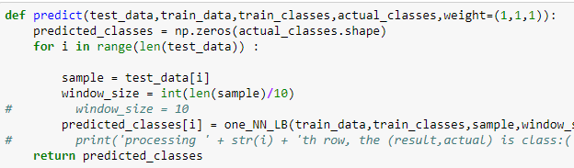
Predict

Slide 8
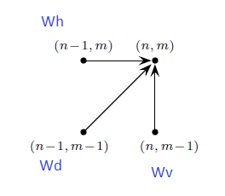
The Weights
(Wv, Wd, Wh)

Slide 9
Asymmetric Weights - Results
(Wv, Wd, Wh)
(Wv, Wd, Wh)/Instances | ECG200 | Coffee | Beef | Beef(L1) | Gun_Point | OliveOil | Lightning7
(1,1,1) | 1.0 | 1.0 | 0.5666 | 0.6666 | 1.0 | 1.0 | 0.808219
(1,1,2) | 0.989 | 1.0 | 0.5666 | 0.6666 | 1.0 | 1.0 | 0.8356
(1,2,1) | 1.0 | 0.96428 | 0.5666 | 0.6666 | 1.0 | 1.0 | 0.83561
(2,1,1) | 0.979 | 1.0 | 0.533 | 0.7000 | 1.0 | 1.0 | 0.8630
It depends.

Slide 10
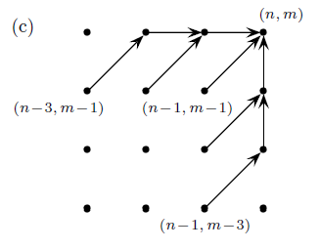
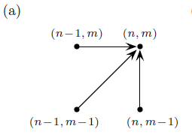
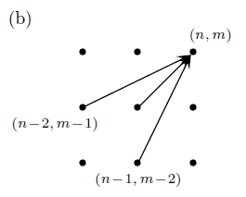
1. DTW Modifications
B. Alternative Step Patterns

Slide 11
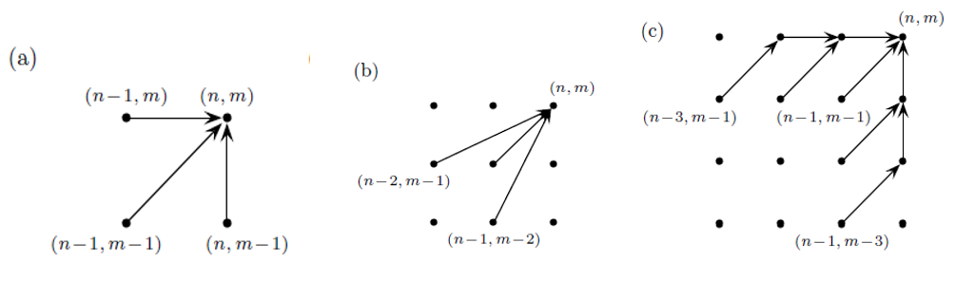
Alternative Pattern - Results
Patterns /Instances | ECG200 | Coffee | Beef | Gun_Point | OliveOil | Lightning7
Pattern (a) | 1.0 | 1.0 | 0.5666 | 1.0 | 1.0 | 0.808219
Pattern (b) | 0.89000 | 1.0 | 0.500 | 1.0 | 1.0 | 0.8904
Pattern (c) | 0.920000 | 0.964285 | 0.5333 | 1.0 | 1.0 | 0.917808

Slide 12
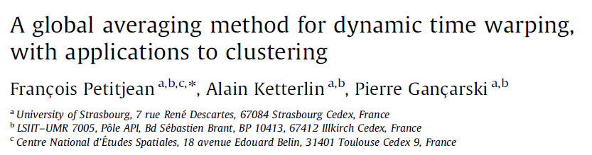
2. Shape Averaging
Found an interesting article.
DTW Barycenter Averaging method (DBA)

Slide 13
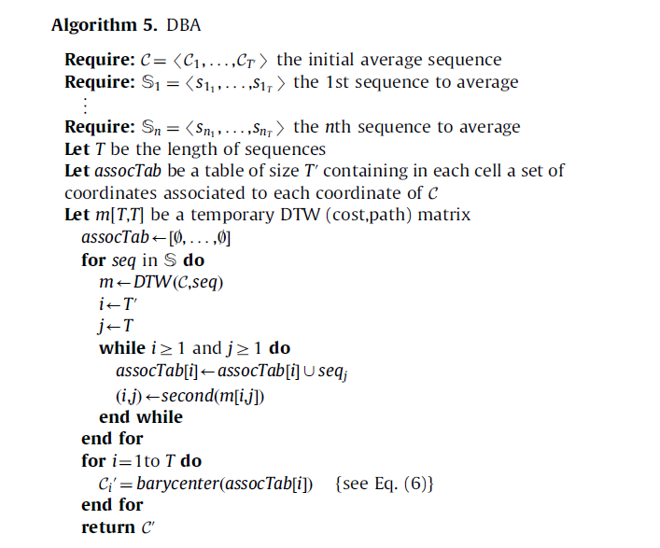

DTW Barycenter Averaging (DBA)

Slide 14
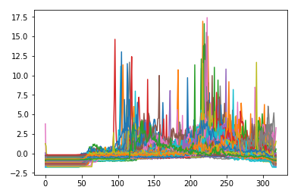
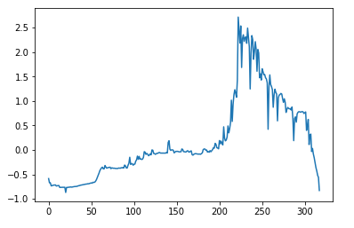
The results – Lightning7
Original
Averaged

Slide 15
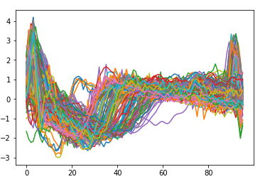
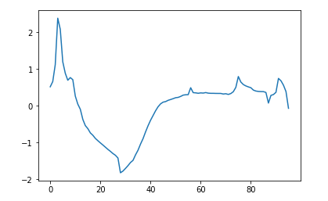
The results – ECG200
Original
Averaged

Slide 16
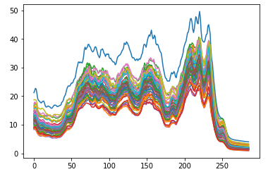
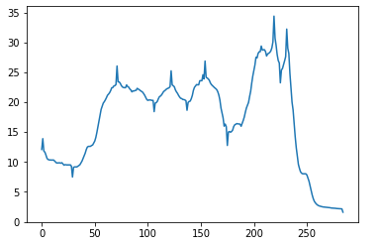
The results – Coffee
Original
Averaged

Slide 17
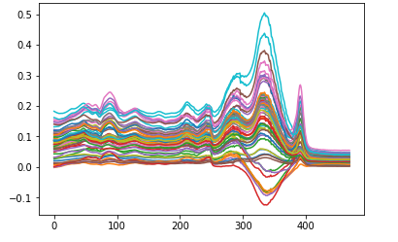
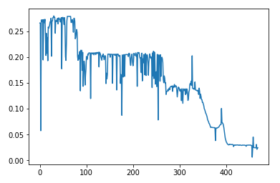
The results – Beef
Original
Averaged

Slide 18
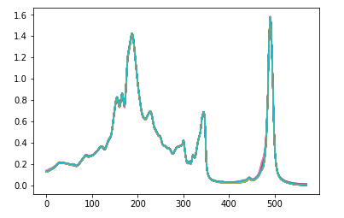
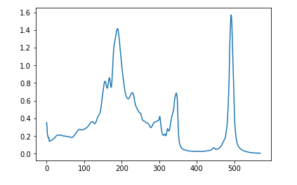
The results – Olive oil
Original
Averaged

Slide 19
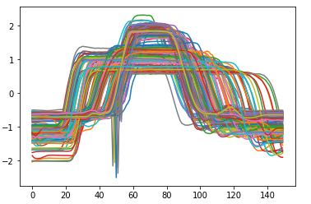
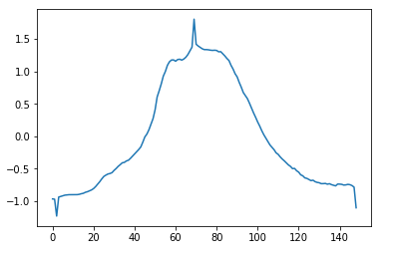
The results – Gun_point
Original
Averaged

Slide 20
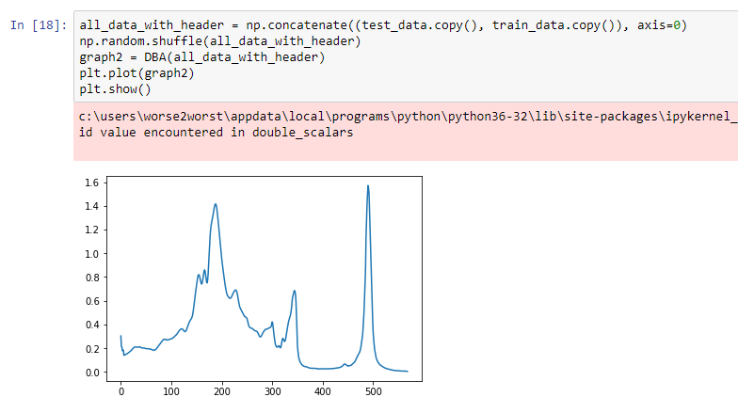
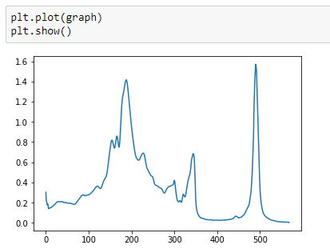
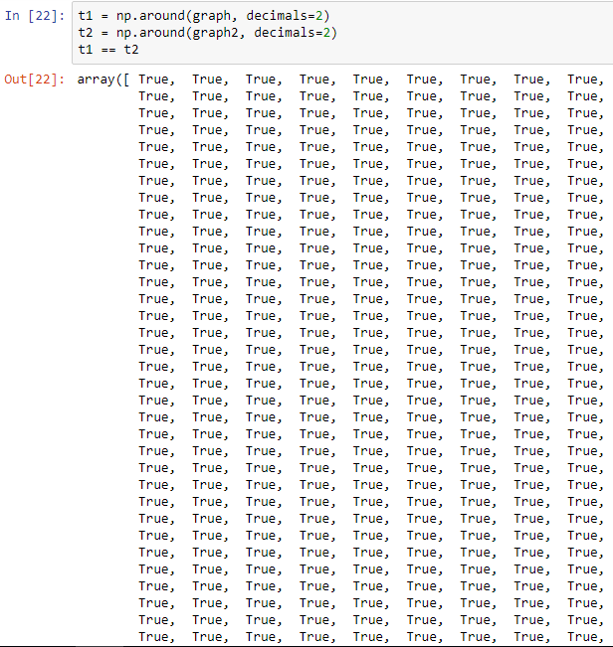
It works!!!
Shuffling!!

Slide 21

THE END

